Slide 1





Team Details
Team Name:
BYTE BRIGADE
SR. NO
ROLE
NAME
ACADEMIC YEAR
1
Team Leader
Prakhar Bajaj
2nd Year
2
Member 1
Raghav Soni
2nd Year
3
Member 2
Parth Kumar
2nd Year
4
Member 3
Mayank Lodhi
2nd Year
Problem Statement PS01 (KLA) - AI-Based Restoration of Degraded Images for Semiconductor Inspection
COLLEGE NAME
LNCT University, Bhopal
TEAM LEADER CONTACT NUMBER
TEAM LEADER EMAIL ADDRESS
+91 91796 86667
prakharbajaj1551@gmail.com

Slide 2


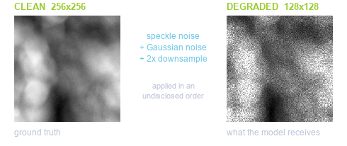
Problem Statement
PS01 - KLA: AI-Based Restoration of Degraded Images for Semiconductor Inspection
DESCRIPTION / DETAILS
Wafer inspection images arrive noisy and low-resolution: fast, low-dose scanning trades image quality for throughput.
Three degradations are present - speckle noise (scales with brightness), additive Gaussian sensor noise, and 2x downsampling - applied in an undisclosed order.
Real defects hide inside this noise. A missed defect can cost an entire wafer; a false alarm wastes engineer time.
Task: learn a mapping from a 128x128 degraded image to its clean 256x256 original, scored on PSNR, SSIM, LPIPS and end-to-end speed.

Slide 3



Idea Description
One small network restores a noisy 128x128 image to a clean 256x256 one - denoising and 2x super-resolution in a single pass, trained only on the data provided.
KEY CONCEPT & APPROACH
1. Supervised on the 3,200 provided pairs - no external datasets, no pretrained restoration weights.
2. One network performs denoising and 2x super-resolution in a single pass.
3. Residual learning - the model corrects rather than generates, which strongly constrains hallucination.
SOLUTION OVERVIEW
NAFNet-SR: 0.53 M parameters, 2.3 MB checkpoint - runs on a laptop CPU.
Trained on the judged metrics: Charbonnier + SSIM + LPIPS loss.
28.00 dB PSNR / 0.759 SSIM / 0.175 LPIPS - beats bicubic on all three.
End-to-end 25 ms per image on a T4 GPU (40 images/second).

Slide 4

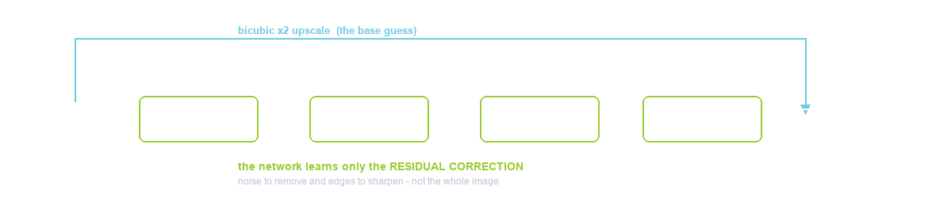
Proposed Solution
NAFNet-SR: 24 NAFNet blocks with 48 channels and a learned 2x PixelShuffle upsampler - 0.53 M parameters, 2.3 MB inference checkpoint.
SOLUTION DETAILS
WHY NAFNet - SOTA quality, no transformer, no activation function. LOSS - Charbonnier + 0.15 SSIM + 0.05 LPIPS (no GAN loss).
TRAINING - 3,000/100/100 seeded split, 128 px crops, batch 16, 100 epochs, ~2 h on a free Colab T4. INFERENCE - directories in/out, batched, tiled.

Slide 5
Innovation and Uniqueness
We train directly on the judged metrics, and constrain the model to correct rather than generate - decisive when invented structure could be mistaken for a defect.
KEY INNOVATION
COMPETITIVE ADVANTAGE
We train directly on the scoreboard: SSIM and LPIPS terms sit inside the loss, so the model optimises two of the three judged metrics rather than hoping they follow from pixel accuracy.
Hallucination is strongly constrained: the global bicubic skip means the network predicts a correction rather than generating an image freely.
Float-faithful pipeline: degraded inputs legitimately exceed [0,1] and we never clip them; clipping is applied only to outputs, where ground truth guarantees the range.
SMALLER: 0.53 M parameters (2.3 MB) vs 10-26 M for Restormer or SwinIR - throughput is a strength, not a compromise.
FASTER: 25 ms per image end-to-end on a T4; all 400 test images in ~10 s.
TRUSTWORTHY: beats the bicubic baseline on 100 of 100 held-out images; failure cases are published and analysed rather than hidden.
REPRODUCIBLE: seeded splits, one-command training and inference, weights and runtime report committed to the repository.
KNOWN LIMITATION: very fine texture gains least - downsampling destroys detail we will not invent.

Slide 6



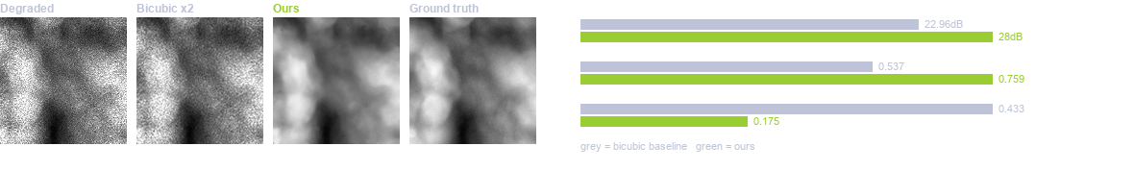
Impact and Benefits
Better on all three judged image-quality metrics, at 25 ms per image - recovering detail that noise would otherwise hide, with no new hardware.
Primary Impact
Quantifiable Outcomes
Detail hidden inside sensor noise becomes visible again - fewer missed defects and fewer false alarms.
Enables faster or lower-dose scanning: recover quality in software, so existing microscopes inspect more wafers.
PSNR 22.96 -> 28.00 dB (+5.04 dB)
SSIM 0.537 -> 0.759 | LPIPS 0.433 -> 0.175
25 ms/image - all 400 test images in ~10 s
0.53 M parameters, 2.3 MB checkpoint - runs on CPU

Slide 7




Technology & Feasibility/Methodology Used
PyTorch and NAFNet-SR, trained in about two hours on a free Colab T4, and deployable on either a GPU or a plain laptop CPU.
IMPLEMENTATION STRATEGY
Trained end to end on a free Google Colab T4 in about two hours; no paid infrastructure was used at any stage.
Inference runs on GPU or CPU. Batched on CUDA, tiled for large images, and verified on 128, 256 and non-square inputs.
Deployment is a drop-in folder-to-folder script plus a Streamlit UI for operators; evaluators need no source-code edits.
Measured, not estimated: benchmark.py reports end-to-end runtime with hardware and software versions stated.
PyTorch 2.11 - NAFNet-SR
NVIDIA T4 / H100 - CPU capable
Colab - Git - Streamlit

Slide 8




GitHub & Video Link
GitHub Repository
github.com/prakharbajaj1551/semicon-image-restoration
Prototype / Simulation Video
https://youtu.be/0eGuJqKfNBQ

Slide 9


Research and References
Research Background & Methodology
Every component is drawn from peer-reviewed restoration research, not invented for this hackathon.
Built on published, peer-reviewed research rather than an unproven design: NAFNet (ECCV 2022) matches transformer restorers at a fraction of the cost.
Loss follows restoration literature - Charbonnier for pixel fidelity, SSIM for structure, LPIPS for perceptual quality.
Validated on a held-out split with no selection leakage, against a bicubic baseline, with failure cases analysed.
References & Citations
The three papers behind our architecture, our upsampler and our perceptual metric.
Ref 1: Chen et al., Simple Baselines for Image Restoration (NAFNet), ECCV 2022 - arxiv.org/abs/2204.04676
Ref 2: Zhang et al., The Unreasonable Effectiveness of Deep Features as a Perceptual Metric (LPIPS), CVPR 2018
Ref 3: Shi et al., Real-Time Single Image Super-Resolution Using an Efficient Sub-Pixel CNN, CVPR 2016

